Slide 1
Gradient Boosting
Ensemble Algorithm
Notes:
https://www.gormanalysis.com/blog/gradient-boosting-explained/

Slide 2
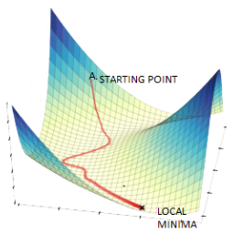
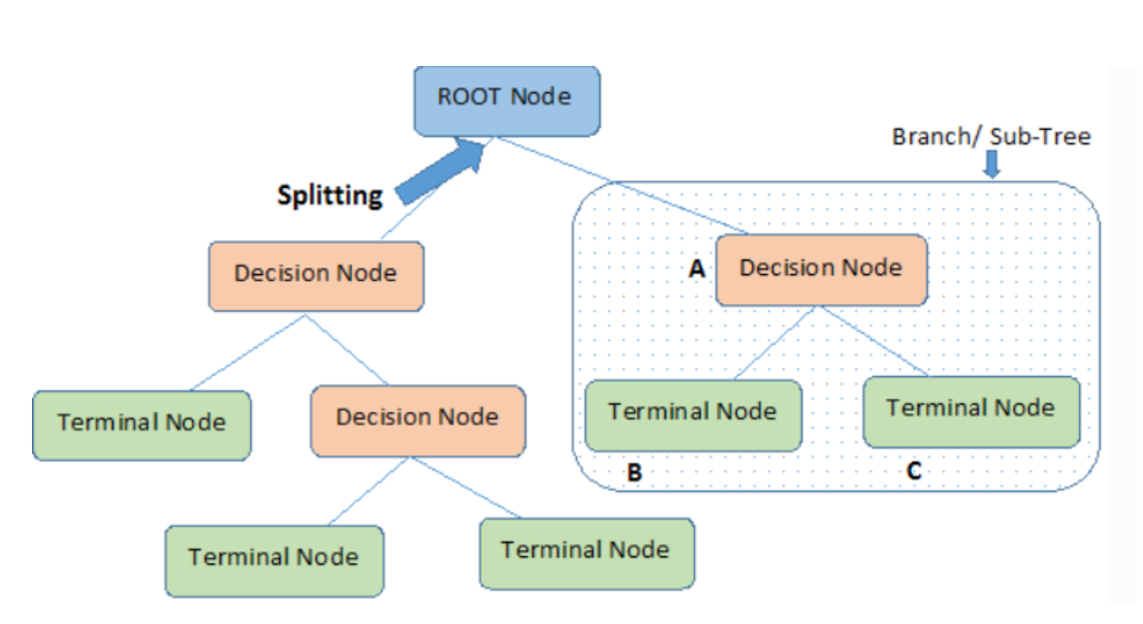
Prerequisites
Gradient Descent
Decision Trees

Slide 3
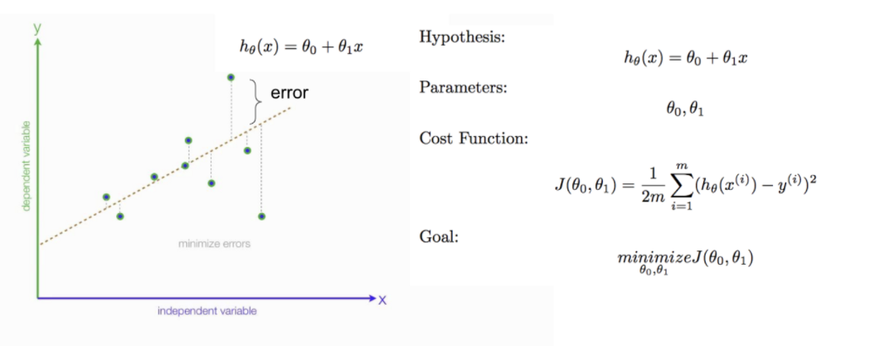
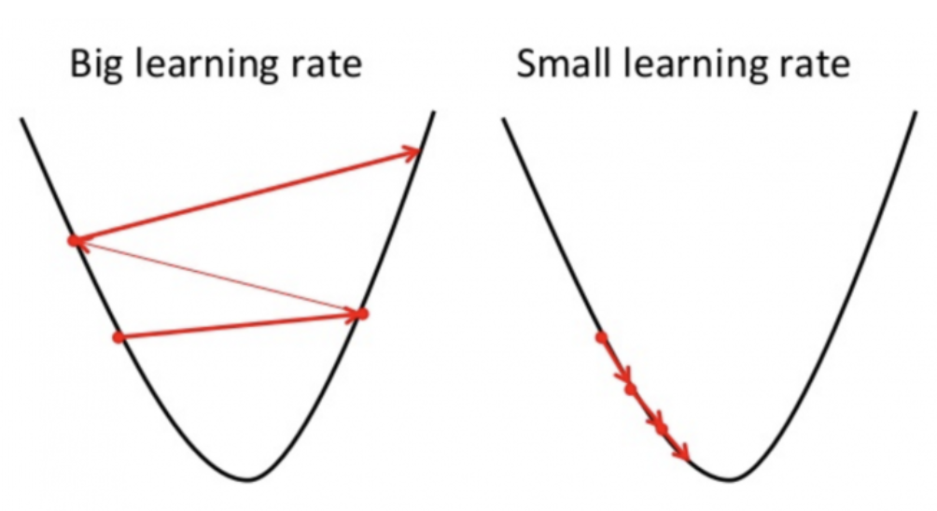
Back to Basics: Gradient Descent
There are 2 concepts in gradient descent that are gradient boosting derives from:
We take the negative derivative AKA negative gradient of the cost function as the gradient is the vector that points in the direct of greatest ascent
The learning rate determines the size of the step
Notes:
Why is it called gradient descent?
Because we take the derivative AKA gradient of the cost function as the gradient is the vector that points in the direct of greatest increase.
So we take small steps (learning rate) continuously in the direction of negative gradient to reach the local minima.

Slide 4
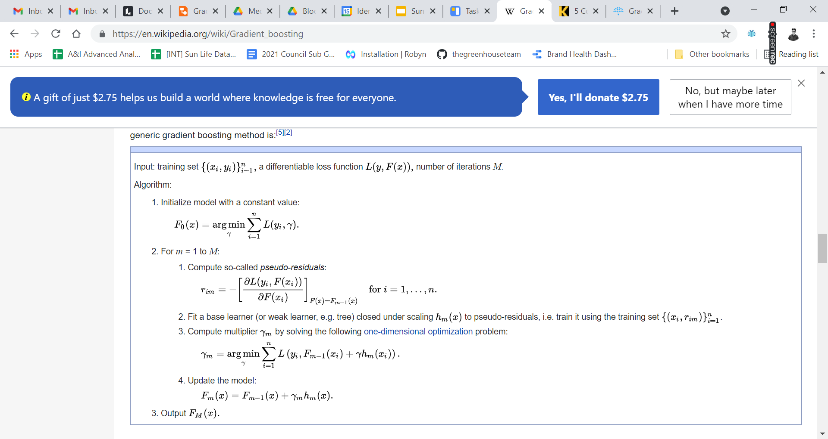
Gradient Boosting Algorithm Steps

Slide 5
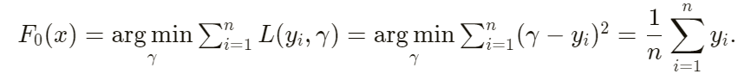
Step 1: Initialize with constant value
When your loss function is mean squared error, we initialize F with the mean of the training target values.
When your loss function is absolute error, we initialize F with the median of the training target values.

Slide 6
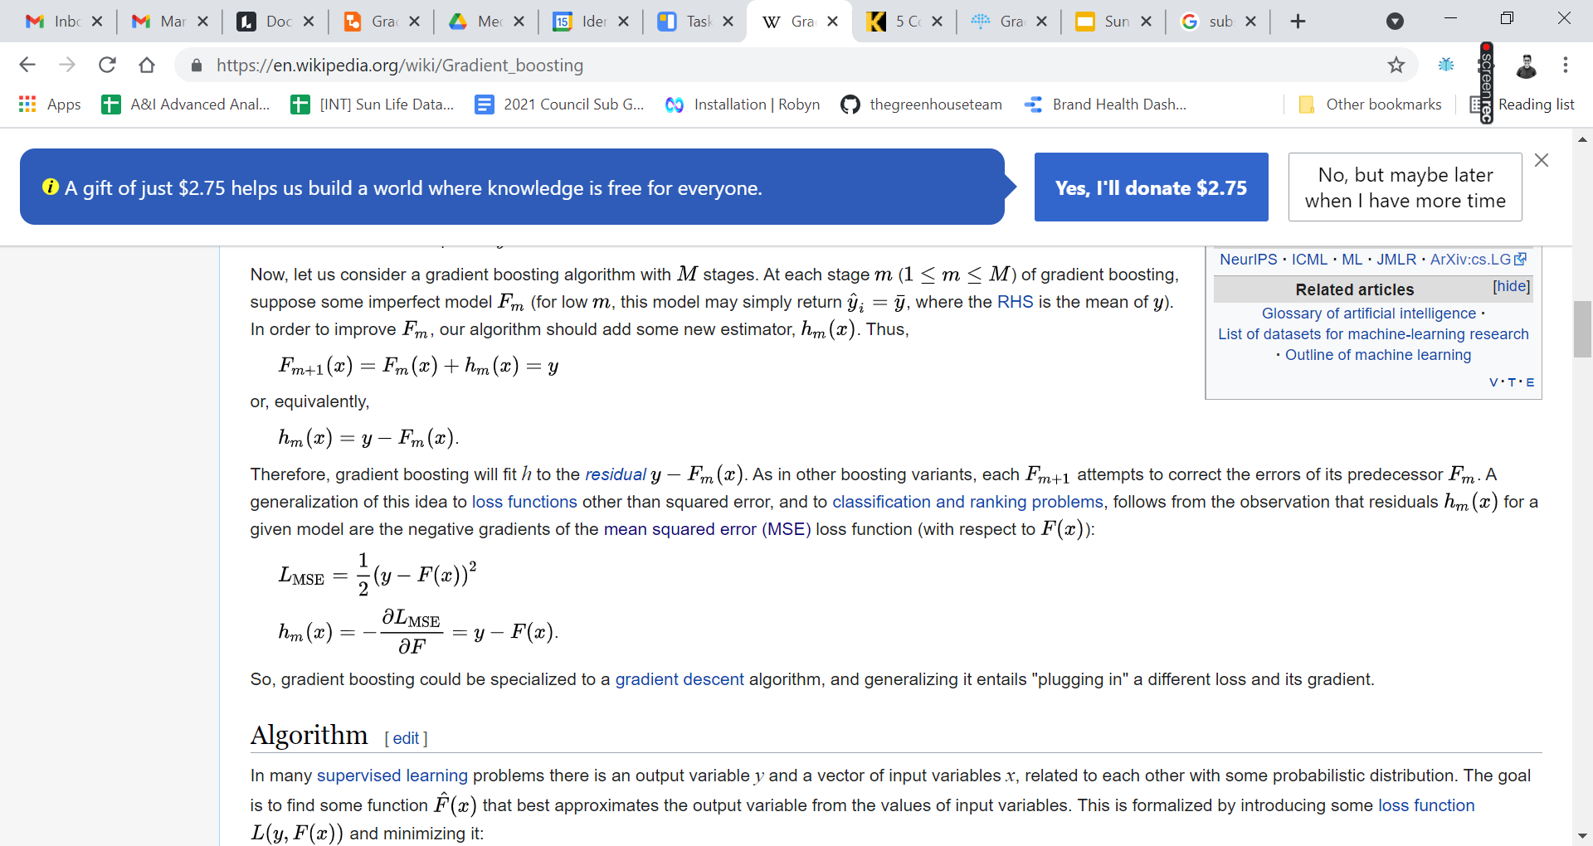
Step 2 (a): Calculate pseudo-residuals
This is the part that I want to demystify. Pseudo-residuals are not actually regression residuals. The pseudo-residuals are a vector that point to the direction of steepest descent of the loss function, aka the negative gradient of the loss function at the value of F_{m-1}(x).
When you use the mean squared error as the loss function, the pseudo residuals are simply the difference. When you use absolute error, the pseudo residuals are 1 or -1, i.e., one step closer in the direction of steepest descent.
Notes:
This is the gradient that gradient boosting gets its name from

Slide 7
Step 2 (b): Fit a learner to pseudo-residuals
This is the genius part of gradient boosting. You are learning the gradient by fitting a learner on the gradient.

Slide 8
Step 2 (c): Compute the multiplier
In the previous steps you found a direction that you want to move in (gradient), now you need the magnitude.
This optimization problem is solved using line search. Each iteration of a line search method computes a search direction and then decides how far to move along that direction to minimize the loss function. It can also be solved analytically, for e.g., the step size is always 1 for MSE loss functions.
It’s important to remember that unlike gradient descent, this step factor not the same as the learning rate. Also, in the case of tree models, we compute a different γ_{m} for every leaf.

Slide 9
Step 2 (d): Update the model
Then repeat the process until you have F_{M}

Slide 10
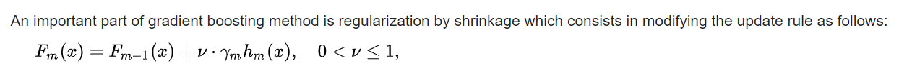
Shrinkage/Regularization
This is the part where the learning rate comes in.
Where parameter ‘nu’ is called the learning rate.
Determines the contribution of each tree on the final outcome and controls how quickly the algorithm proceeds down the gradient descent (learns). Values range from 0–1 with typical values between 0.001–0.3.
Smaller values make the model robust to the specific characteristics of each individual tree, thus allowing it to generalize well and make it easier to stop prior to overfitting; however, they increase the risk of not reaching the optimum with a fixed number of trees and are more computationally demanding.

Slide 11
Two Categories Hyperparameters
Boosting hyperparameters
Number of trees
Learning rate
Tree-specific hyperparameters
Tree depth: Typical values range from a depth of 3–8
Minimum number of observations in terminal nodes aka complexity of the tree: Typical values range from 5–15
Notes:
https://bradleyboehmke.github.io/HOML/gbm.html

Slide 12
General Tuning Strategy
Choose a relatively high learning rate. Generally the default value of 0.1 works but somewhere between 0.05–0.2 should work across a wide range of problems.
Determine the optimum number of trees for this learning rate.
Fix tree hyperparameters and tune learning rate and assess speed vs. performance.
Tune tree-specific parameters for decided learning rate.
Once tree-specific parameters have been found, lower the learning rate to assess for any improvements in accuracy.
Use final hyperparameter settings and increase CV procedures to get more robust estimates. Often, the above steps are performed with a simple validation procedure or 5-fold CV due to computational constraints. If you used k-fold CV throughout steps 1–5 then this step is not necessary.
Notes:
https://bradleyboehmke.github.io/HOML/gbm.html

